Slide 1
CUDA Advanced Libraries
cuFFT for Image/Video Processing

Slide 2
Detect if an Image is Blurry
Import image
FFT image
Perform FFT shift to center of image
Remove lower frequencies
Perform inverse FFT shift back to top left
Perform inverse FFT on image
Determine the magnitude spectrum of image
Calculate the mean
If mean is below a threshold, it is blurry
[1]

Slide 3
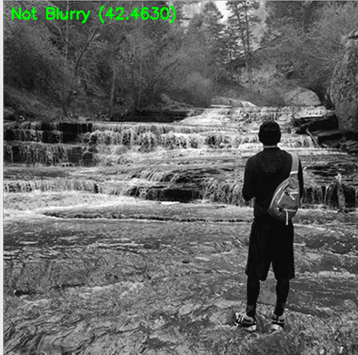
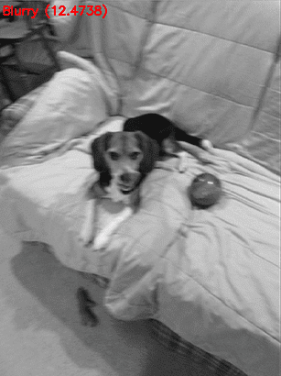
Blurry Image Detection
[1]

Slide 4
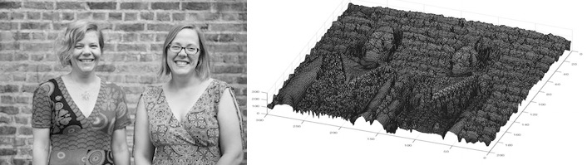
3D from Greyscale
[2]

Slide 5
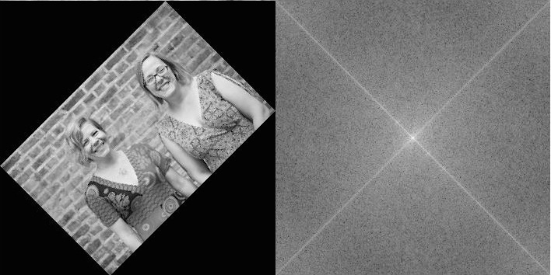
Rotate Images
[2]

Slide 6
How Could it Apply to video?
Perform visual effects faster, instead of say calculating the transformation of each pixel for an effect use FFT to perform incremental effects over time
Consider the video as a single 3D array of data and perform transformations by pixel or column/row of pixels
Based on a series of 3D renderings from single images construct complete 3D models of objects, people, etc.

Slide 7
References
[1] 2020. Adrian Rosebrock. PyImageSearch. OpenCV Fast Fourier Transform (FFT) for blur detection in images and video streams. Found at https://www.pyimagesearch.com/2020/06/15/opencv-fast-fourier-transform-fft-for-blur-detection-in-images-and-video-streams/.
[2] 2017. Rachel Thomas. Fourier Transforms of Images. Found at https://plus.maths.org/content/fourier-transforms-images

